Slide 1
Web store navigator
STEP BY STEP EXPLANATION ON USING THE WEBPAGE.

Slide 2
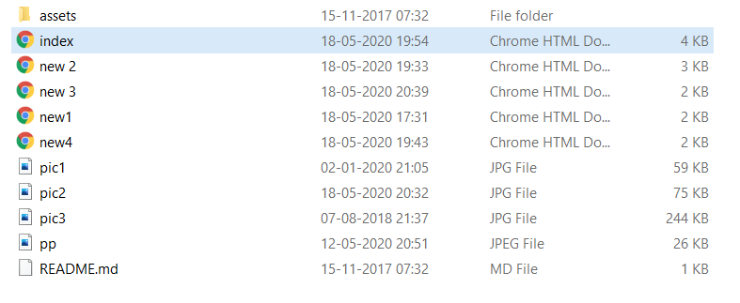
STEP 1: From the given set of files in the folder, index.html file is the home page of the website which will redirect to other pages. So first we need to open index.html file with browsers like Internet Explorer, Mozilla Firefox or Google Chrome etc.

Slide 3
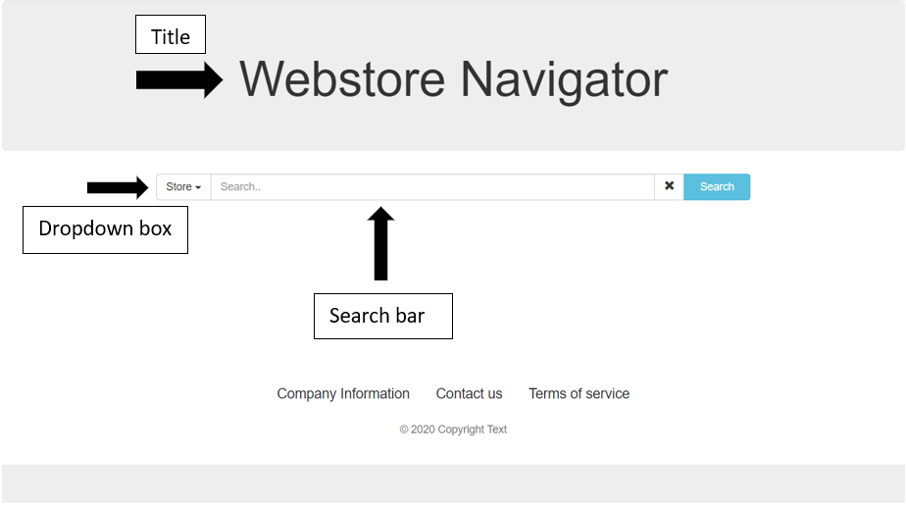
STEP 2: After opening the file in a browser, we can see the title of the website and followed by that, we can see a search bar with a drop down box on the left and a search button on the right.

Slide 4
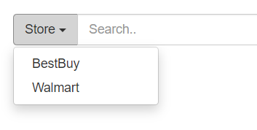
STEP 3: That drop down box on the left consists of two online shopping portals present in the market Wal-Mart and BestBuy. After selecting the desired website from the two we can search for the product we want in the search bar and hit the search button.

Slide 5
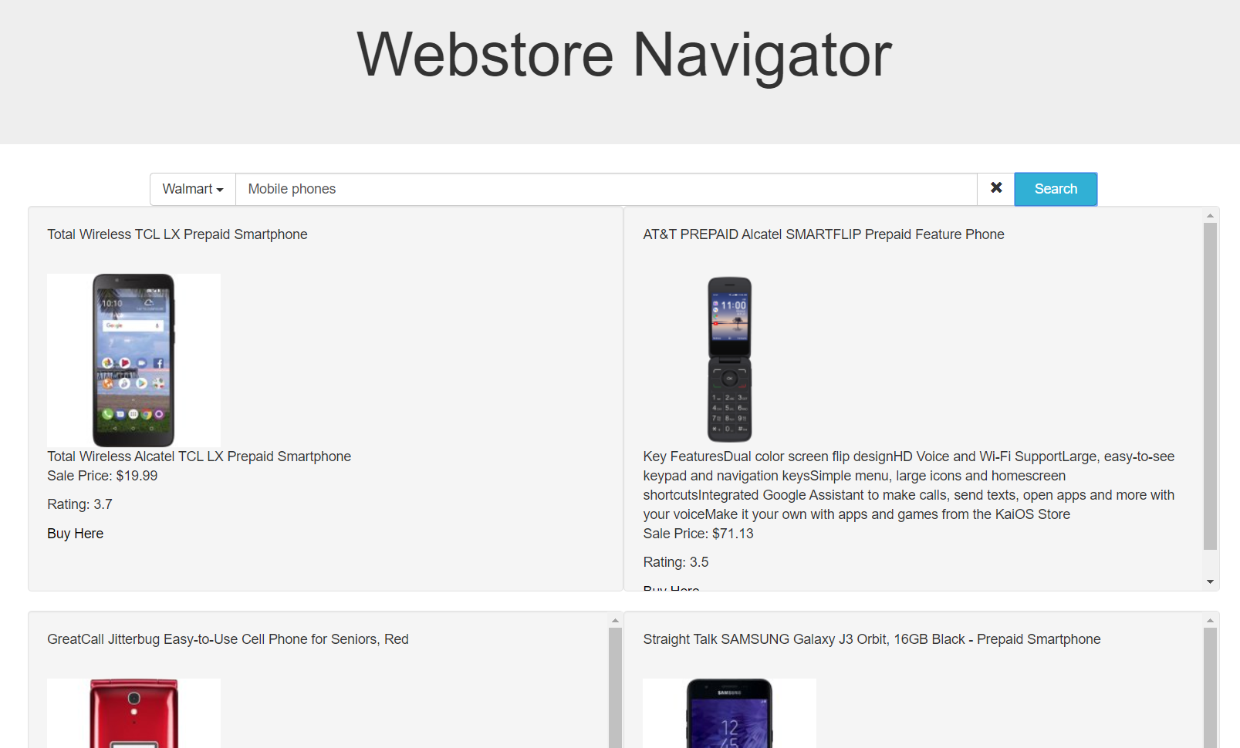
STEP 4: When the search button is clicked, the products similar to the requirement given are displayed with the descriptions of those products along with the price.

Slide 6
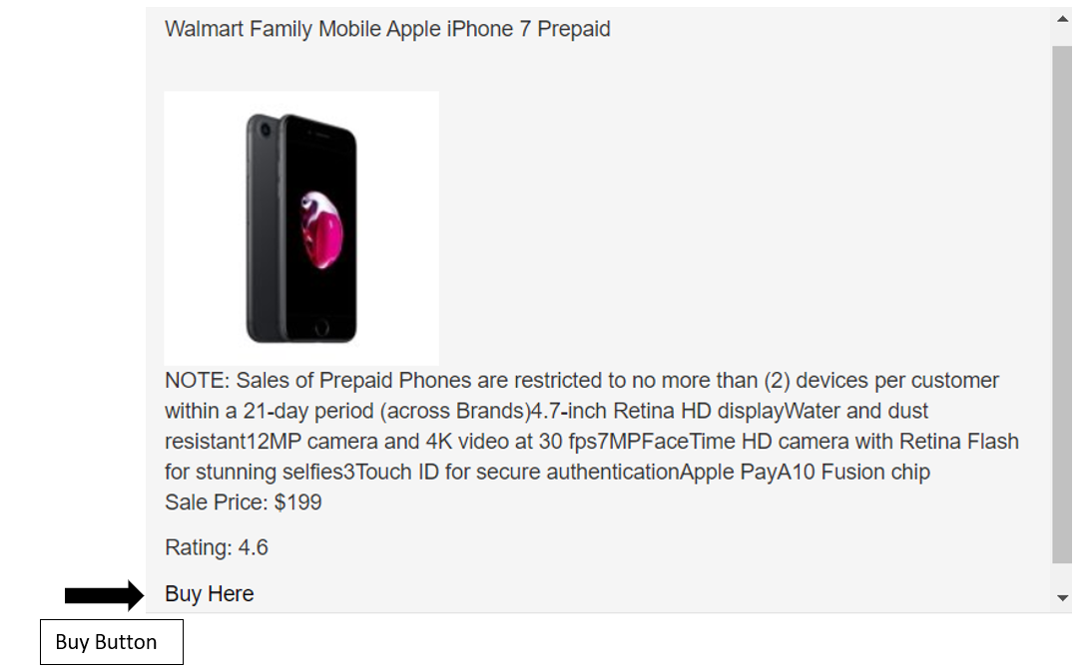
STEP 5: Search for the desired product in the displayed list and click buy button which is right under the description of that particular product.

Slide 7
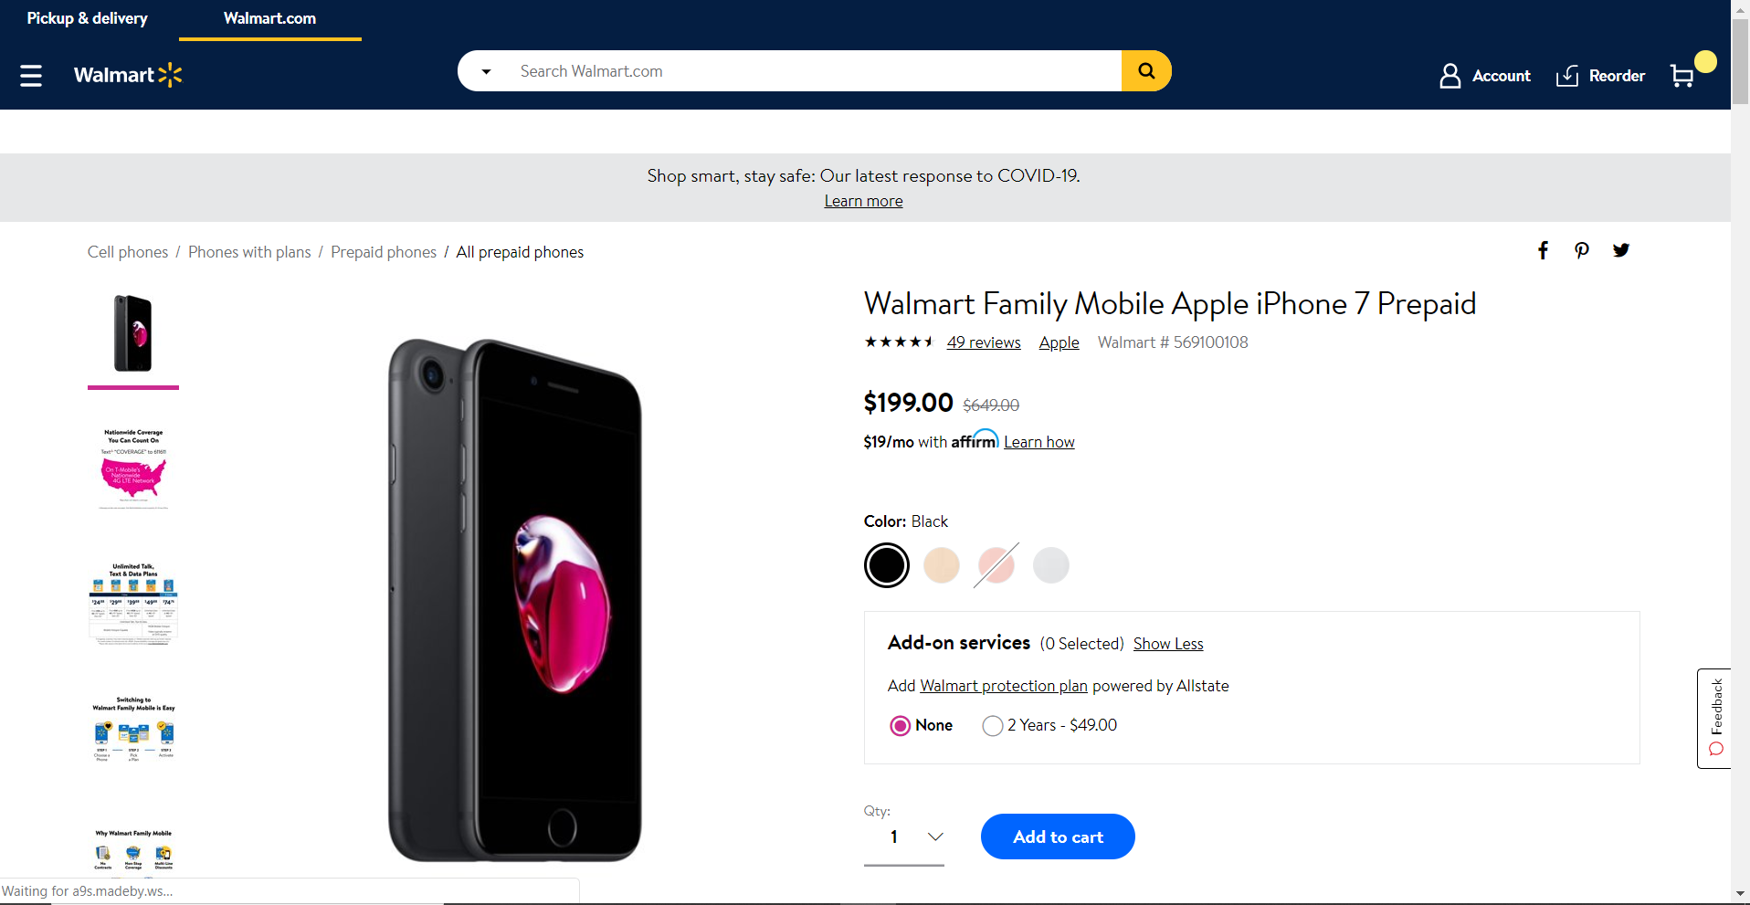
STEP 6: When we hit the buy button, the page will automatically redirected to the respective website given.

Slide 8

STEP 7: Also, the three options available in the footer of the home page can be accessed for necessary purposes.

